Slide 1

Nashville Traffic
What happens on Thursdays ?

Slide 2
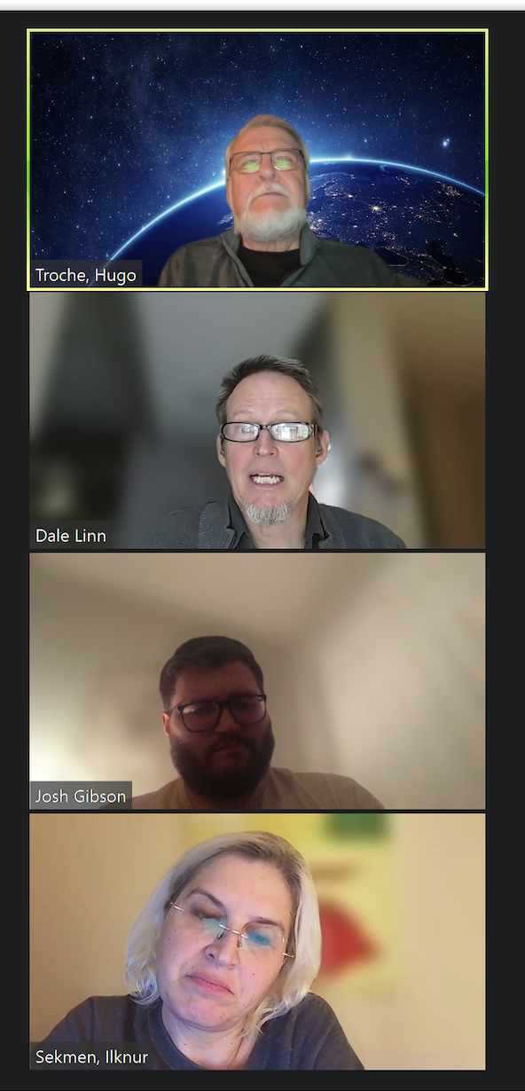
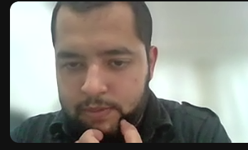
Teamwork, planned step by step
Thank you Ahmad for your valuable help !

Slide 3
Nashville Traffic project steps
Definition of the idea: What happens on Thursdays
A priori relevant variables search
Data Search
Data Understanding
Data Processing with Pandas in Jupyter Notebook
Graphics
Check of Results
Consolidation

Slide 4
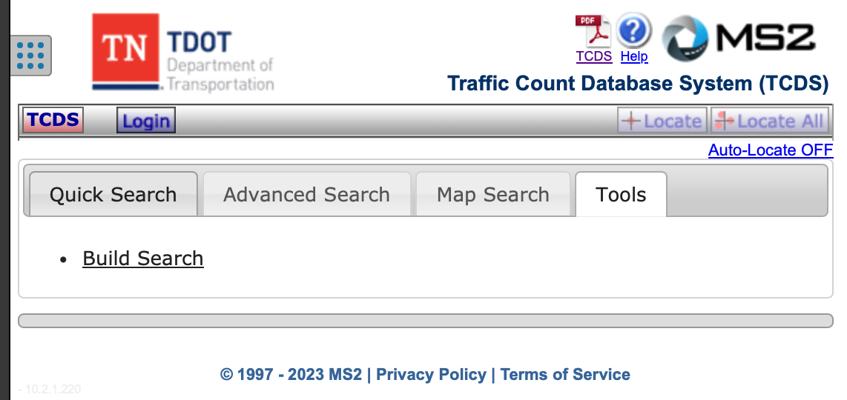
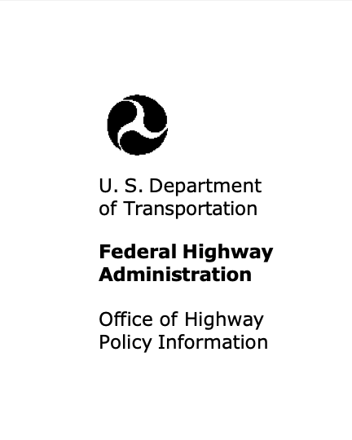

Data Search
TomTom not useful, only real time data (for free)
TN TDOT
U.S. Department of Transportation
Federal Highway Administration

Slide 5
TN TDOT – part 1
We searched for all the places where TDOT measures traffic (Station_ID)

Slide 6
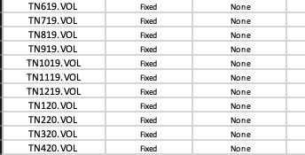
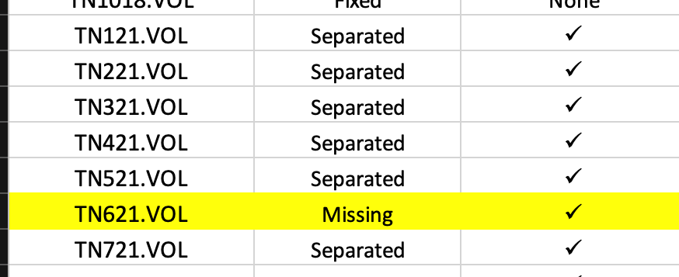
TN TDOT – part 2
We downloaded sixty files with Data from 2018 to 2022, including:
Fixed separation files
CSV files

Slide 7
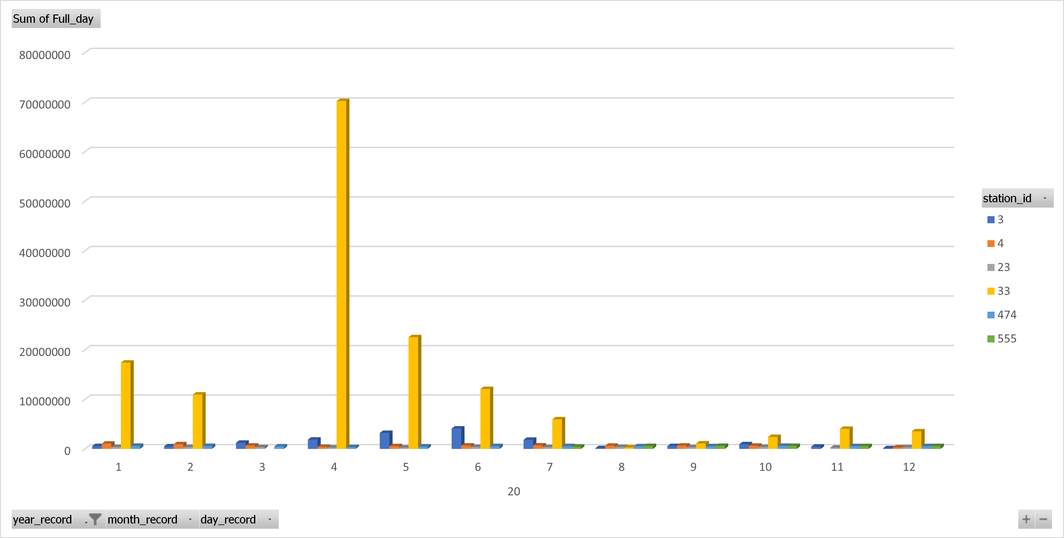
We had to RECHECK the 60 files after a week of work ……. Because of results like this

Slide 8

What did we do ? Talk to the experts in TN TDOT
They clarified concepts and told us what was wrong …. And we started over

Slide 9
Nashville Traffic project steps
Definition of the idea: What happens on Thursdays
A priori relevant variables search
Data Search
Data Understanding
Data Processing with Pandas in Jupyter Notebook
Graphics
Check of Results
Consolidation

Slide 10

What did we do ?
Used Pandas to create CSV files
Manipulated the CSV files in Excel
Analyzed in detail relevant variables

Slide 11
Nashville Traffic project steps
Definition of the idea: What happens on Thursdays
A priori relevant variables search
Data Search
Data Understanding
Data Processing with Pandas in Jupyter Notebook
Graphics
Check of Results
Consolidation

Slide 12
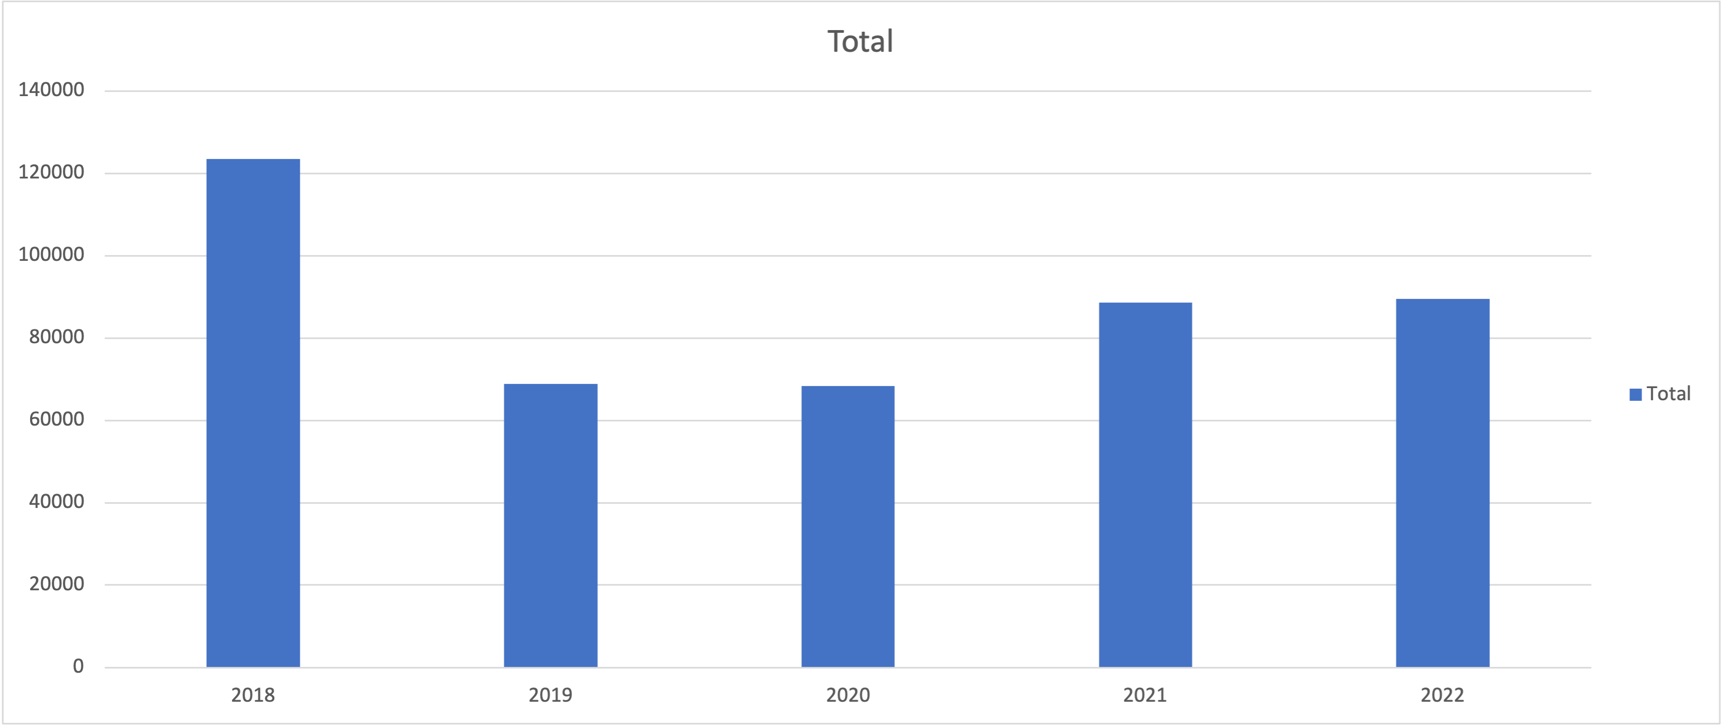
Davidson Yearly Traffic
Covid effect is clear, recovery comes slow

Slide 13
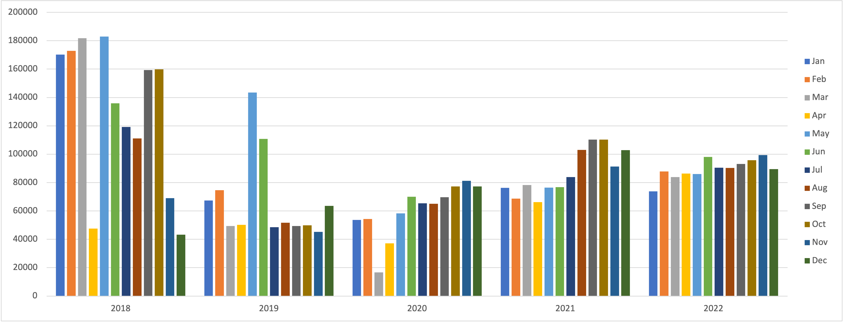
Davidson Monthly Traffic
Jan and Feb never recovered since 2018
May and June spikes are gone after Covid
Traffic is more uniform in 2021 and 2022

Slide 14
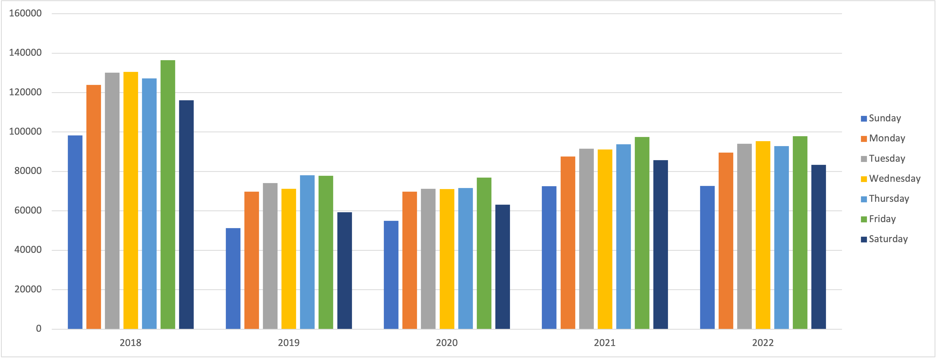
Davidson Daily Traffic
Friday is the busiest day
Thursday follows, but not closer
Recovery from Covid is uniform

Slide 15
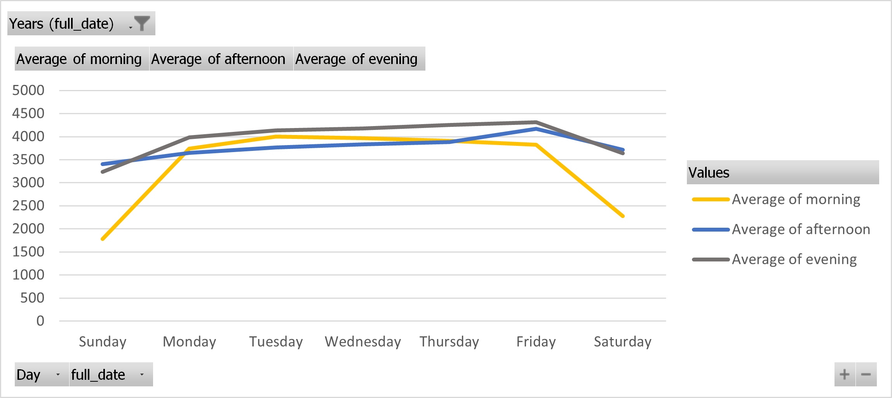
The busiest and slowest segments of the day in 2018
Friday evening is the busiest
Sunday morning is the slowest
Traffic is constant during the work days

Slide 16
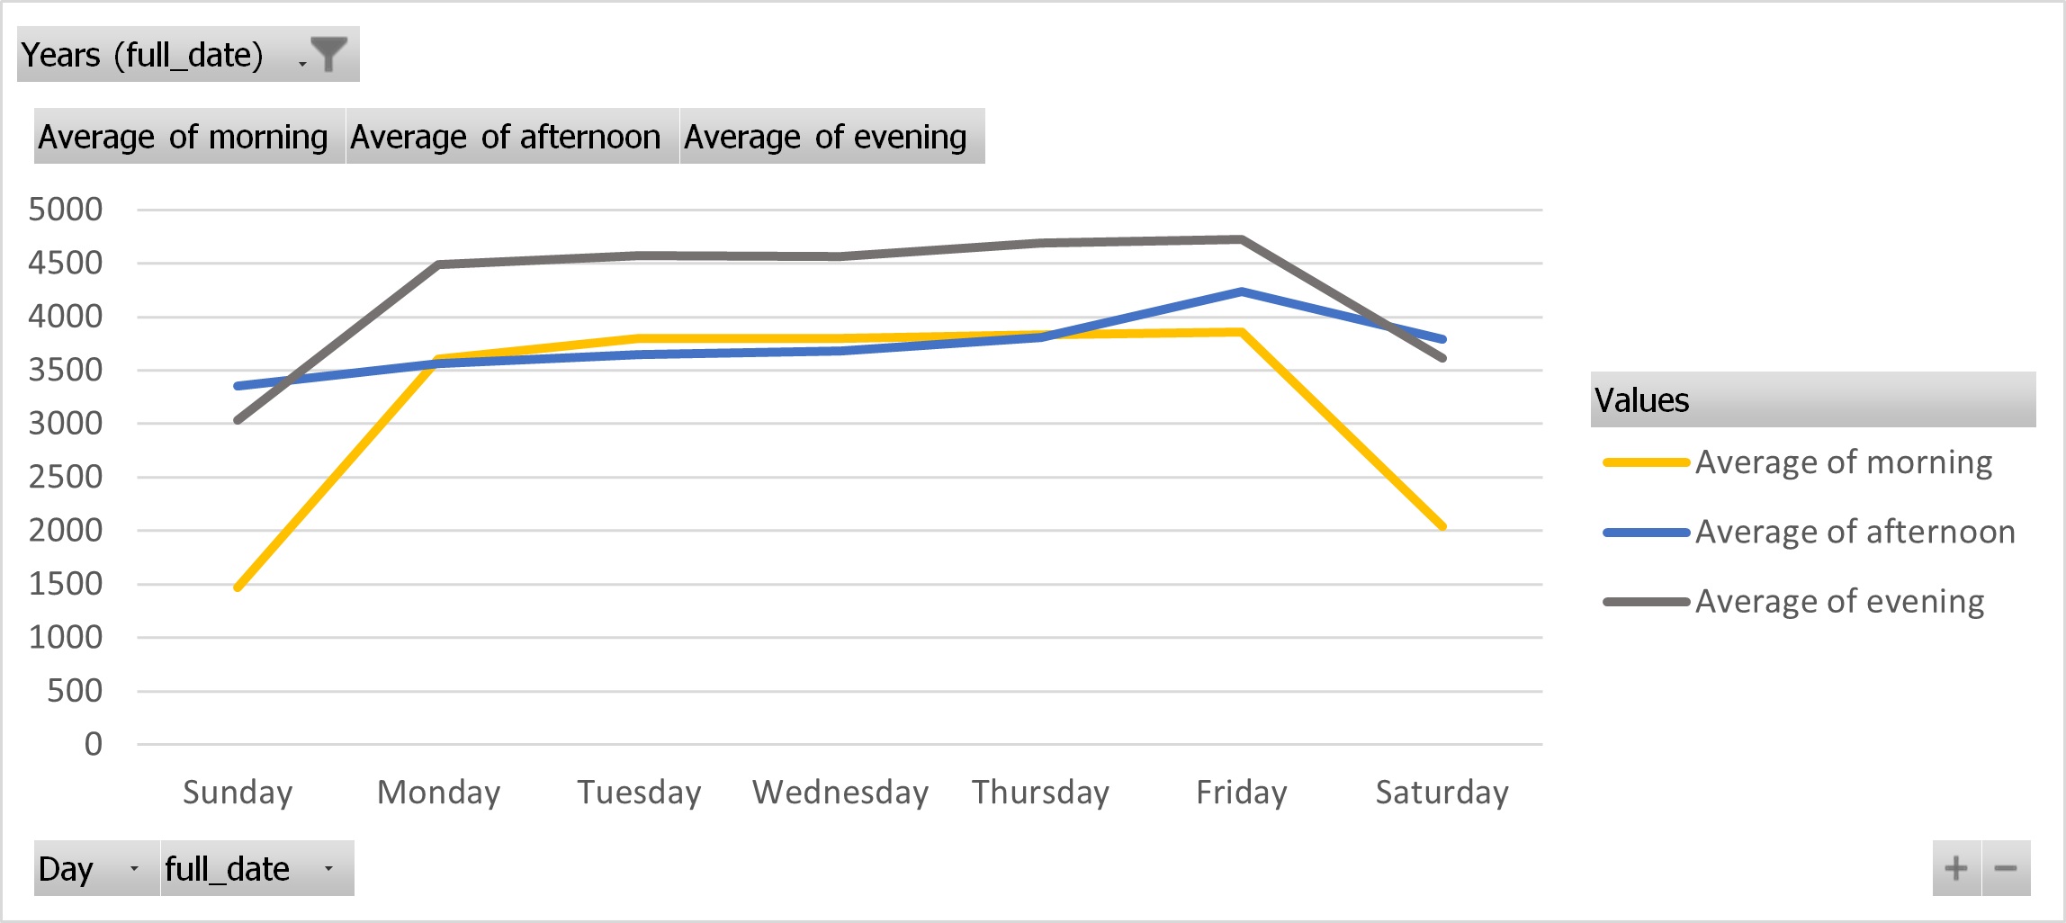
The busiest and slowest segments of the day in 2019
Compared to 2018 there is a bigger difference between the evening and the other times of the day
Shapes are the same as in 2018

Slide 17
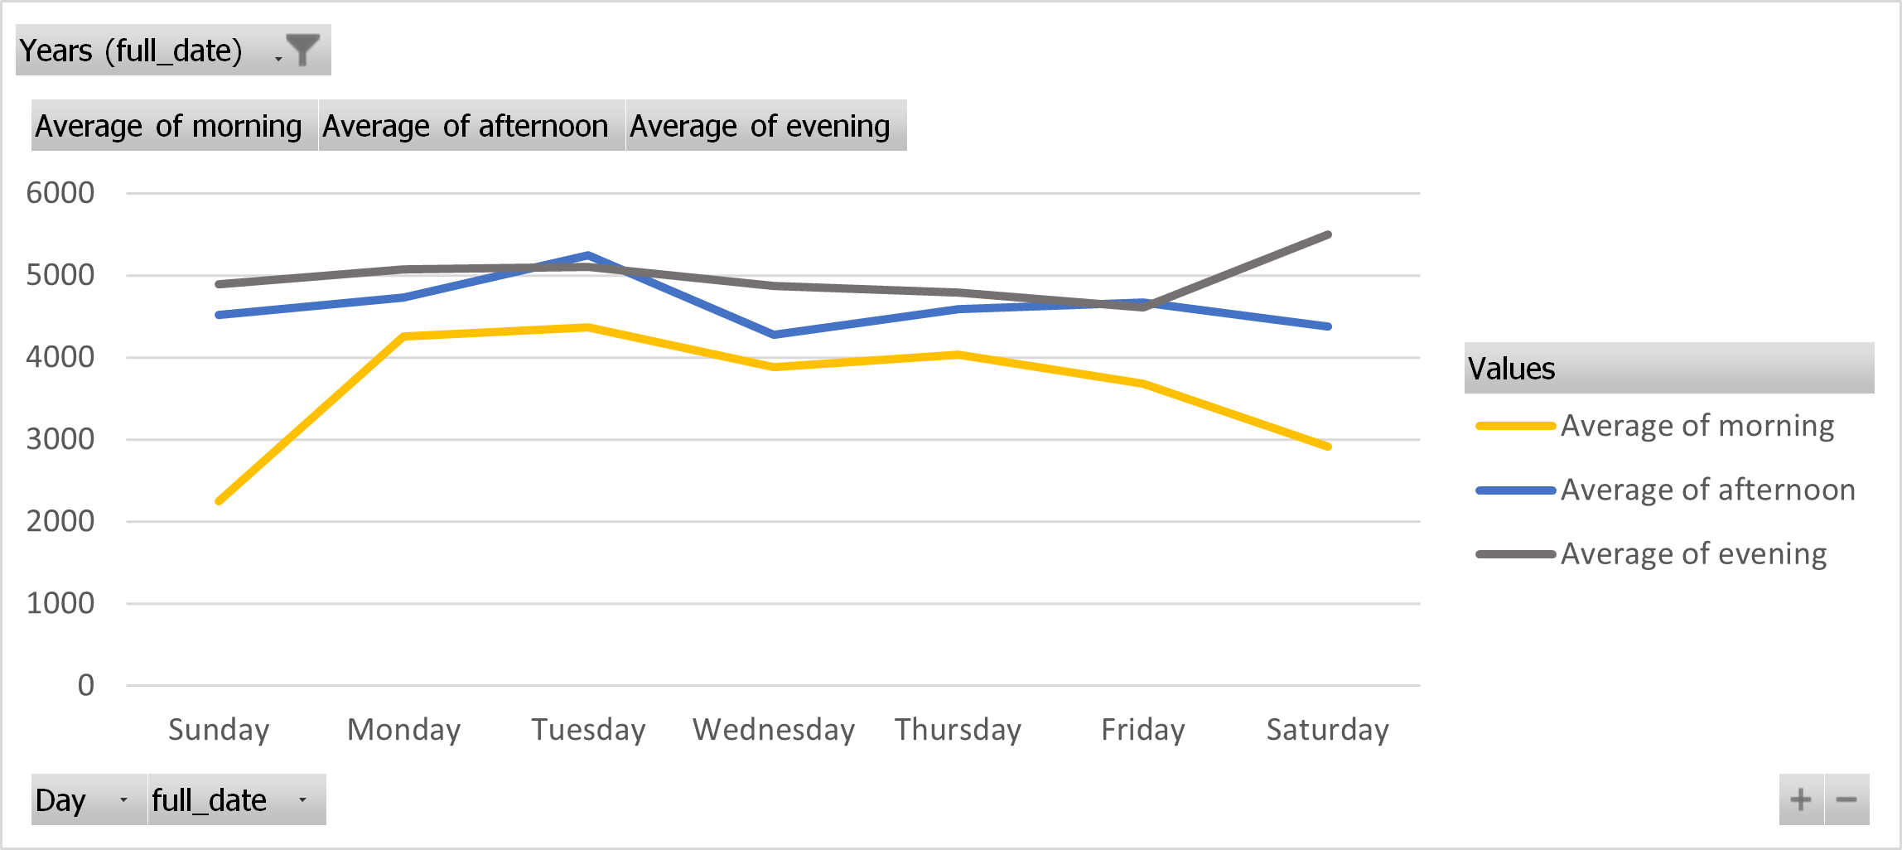
The busiest and slowest segments of the day in 2020
The afternoon gets closer to the evening
Saturday has more traffic in the evening

Slide 18
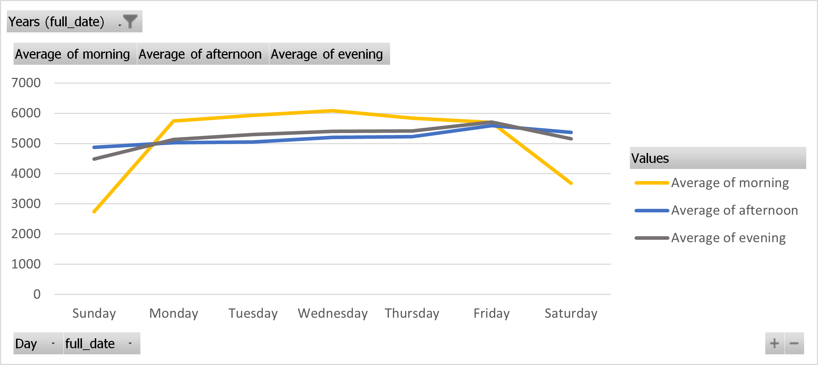
The busiest and slowest segments of the day in 2021
The shape has changed from 2020
The morning is busier !

Slide 19
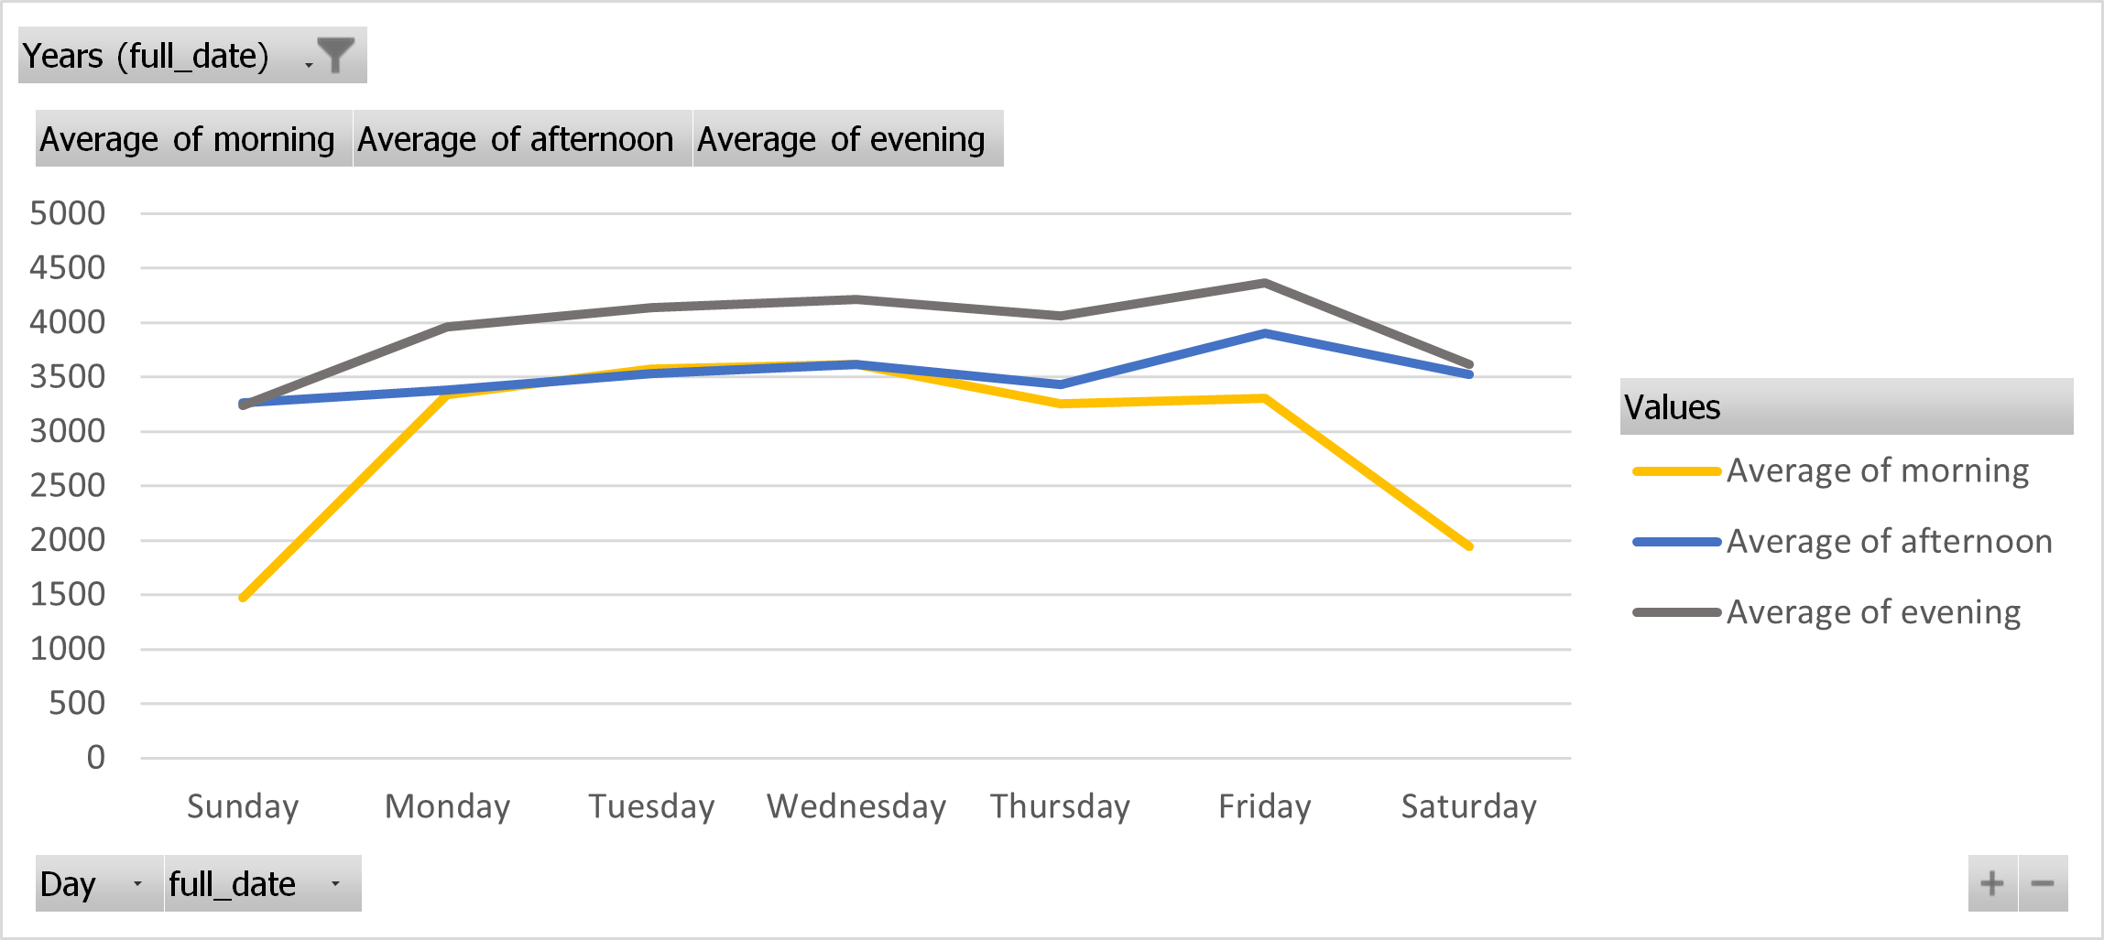
The busiest and slowest segments of the day in 2022
Shape looking as 2018 and 2019
Evening is busier
Morning is clearly lower, except from Monday to Thursday

Slide 20
Nashville Traffic project steps
Definition of the idea: What happens on Thursdays
A priori relevant variables search
Data Search
Data Understanding
Data Processing with Pandas in Jupyter Notebook
Graphics
Check of Results
Consolidation

Slide 21

What other factors affect Nashville traffic?

Slide 22
A priori relevant variables search
Population change
Accidents

Slide 23

Motor Vehicle Accidents and Emergencies

Slide 24
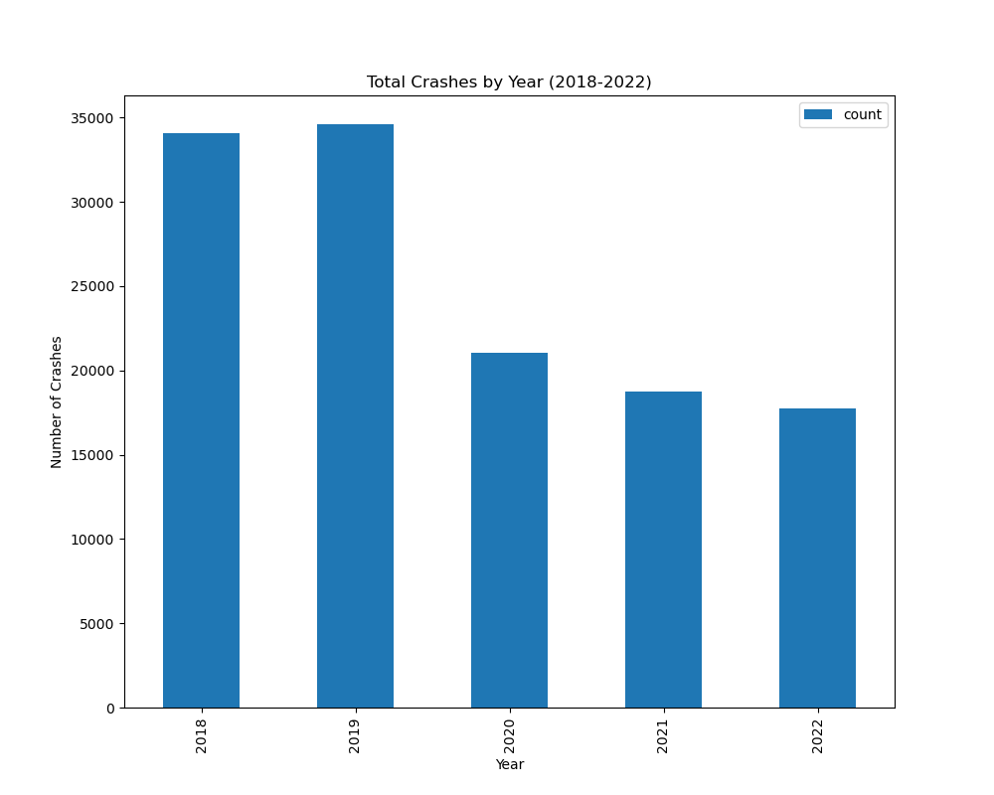

Slide 25
What’s The Trend of Total Nash-Crashes?
From 2019 onward, the number of traffic accidents have actually DECREASED over time.
Are Nashville drivers actually getting better at driving ?

Slide 26
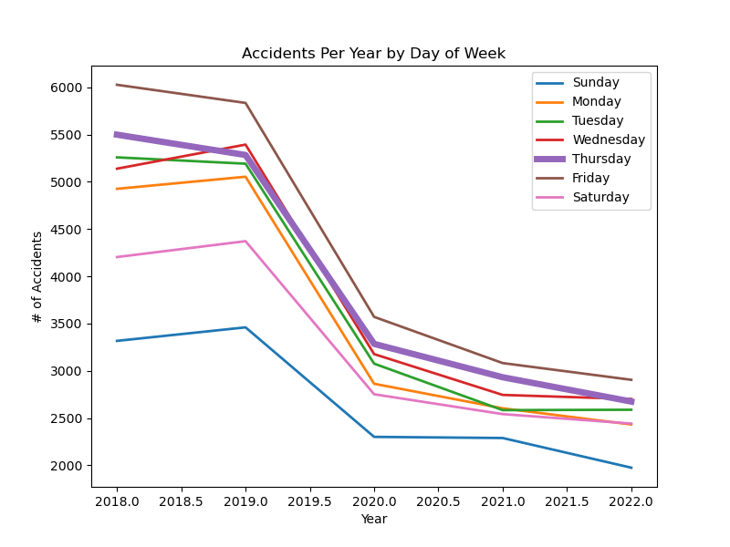
Crashes by Day of Week for the last 5 years
Fridays consistently had more accidents
Most other days had a similar number of accidents
Thursdays had the second most accidents in both 2018 and 2021.

Slide 27
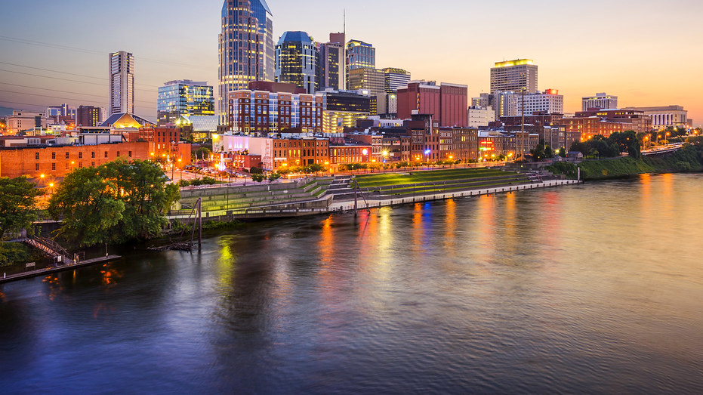
What about Nashville’s Population?
This Photo by Unknown Author is licensed under CC BY-SA

Slide 28
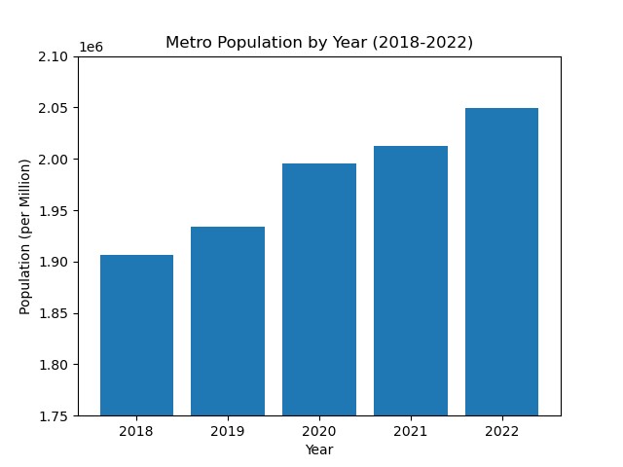
The Population Keeps Rising
- The Metro Nashville area population has been steadily increasing each year.
- This data includes the surrounding areas such as Franklin and Murfreesboro, etc.
- This trend goes as far back as 2010.
Source: https://www.statista.com/statistics/815653/nashville-metro-area-population/

Slide 29
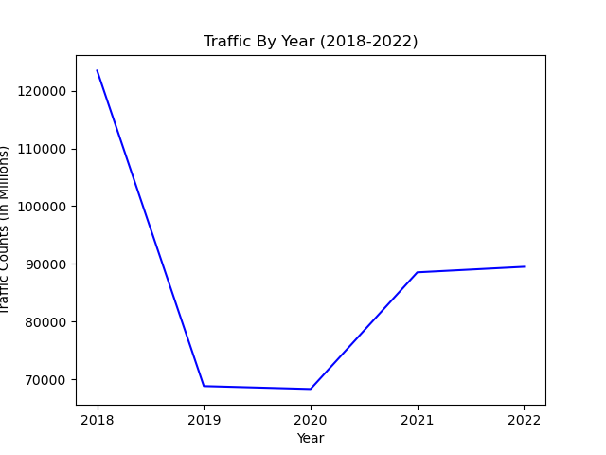
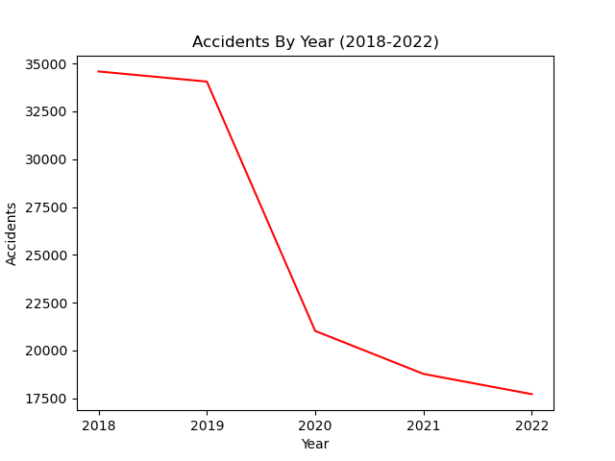
Is There A Correlation Between Traffic and Accidents?
Drivers seem to get better

Slide 30
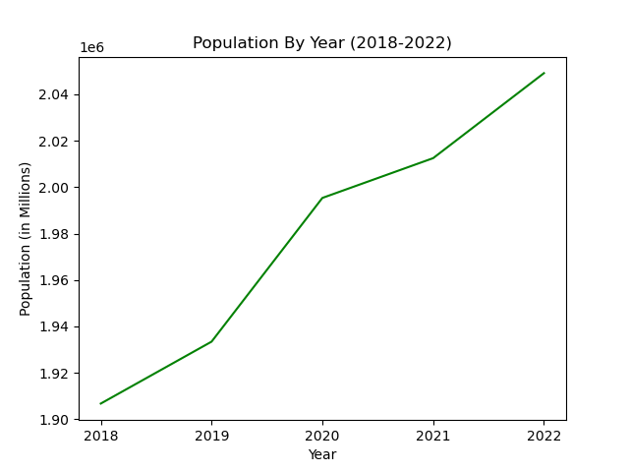
What about a Correlation Between Traffic and Population?
Not really

Slide 31
Nashville Traffic project steps
Definition of the idea: What happens on Thursdays
A priori relevant variables search
Data Search
Data Understanding
Data Processing with Pandas in Jupyter Notebook
Graphics
Check of Results
Consolidation

Slide 32
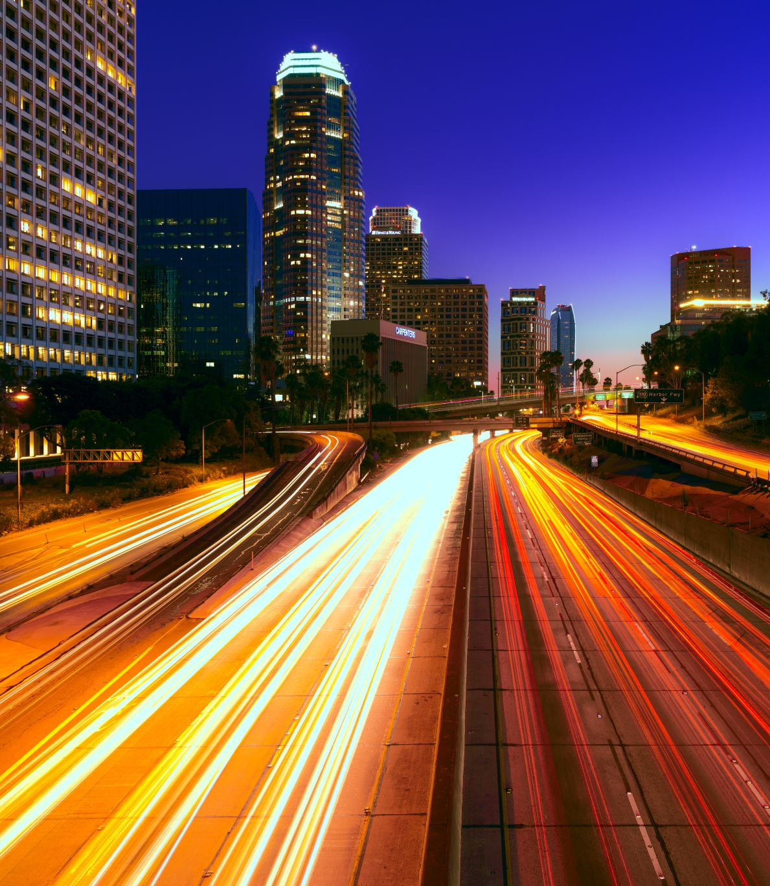
Nashville’s Thursday traffic has indeed changed!
(just not that much)

Slide 33
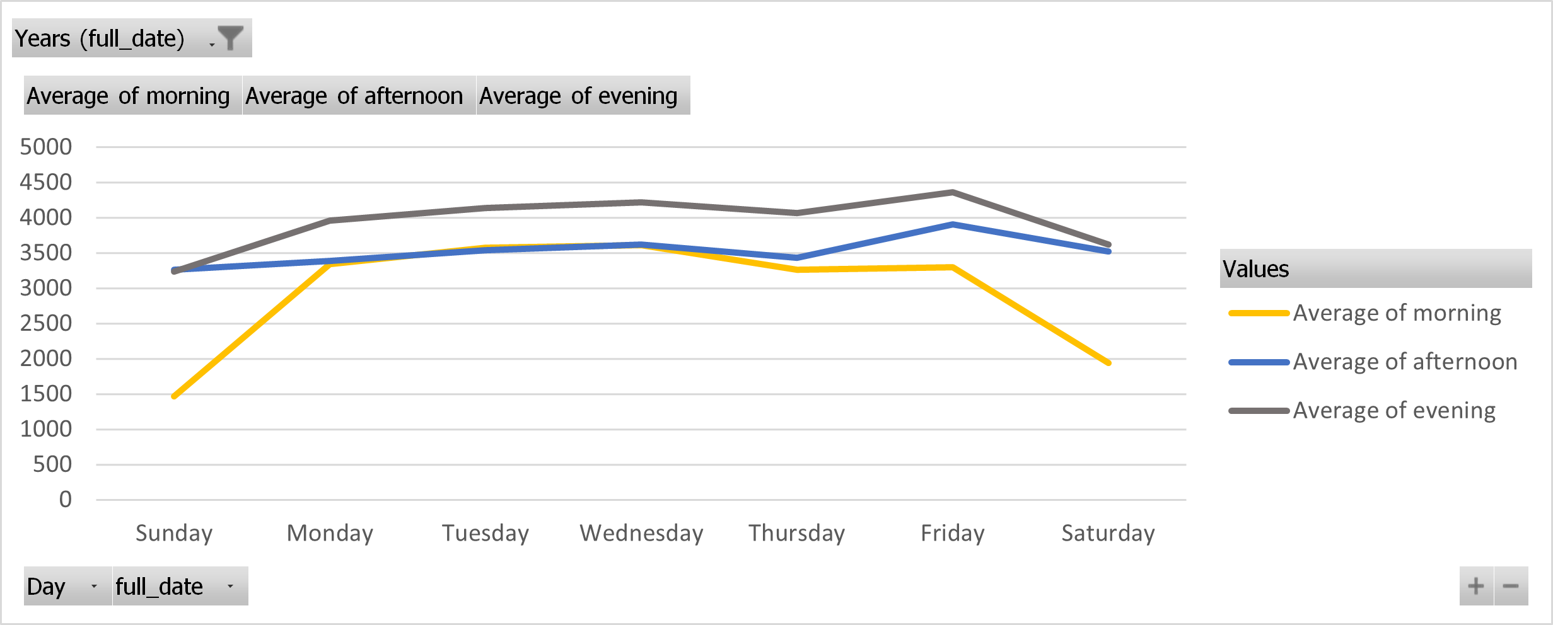
NULL HYPOTHESIS
Team Two is excited to report that Thursday traffic is not all that special.

Slide 34
Limitations 2023 data not available
Most local counting stations move around.
We used 9 stations for the big picture data.
We used 3 stations for the segment data.
Our TDOT experience taught us that traffic data is volatile.
With more time, TDOT may have been more responsive.
With more money, we could have purchased good data.
With a team of traffic study veterans, we could have avoided some adventures with data

Slide 35

Follow Up Research
What’s going on with Wednesdays?

Slide 36

Lessons learned in this project
Work as a team WORKS
In real world projects hire an expert in the field; it will save time and money, making sure the result are reliable

Slide 37

Thumbs up, please !

